Slide 1
Online Law Firm
Lunodzo Mwinuka (1302090/T.14)
BSc Information Technology & Systems
Notes:
Introduce yourself, Name and Course

Slide 2
Background & Problem Statement
Law Firms’ operation model
Records management at “BLS Attorneys”
Risk to loosing Case files and Client Records
Time Costs
Notes:
Law Firms are basing on interaction between Lawyers and Clients which needs documentation of cases and issues
Firms fail in time management due to physical interaction and Manual Case processing

Slide 3
Main Objective
Design and develop a web based system to help Firm’s Managers to manage Lawyers, Clients and Cases
Other Objectives
Interactive User interface
Security
Visibility

Slide 4
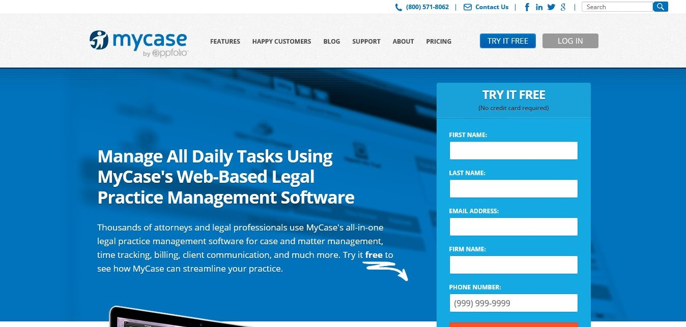
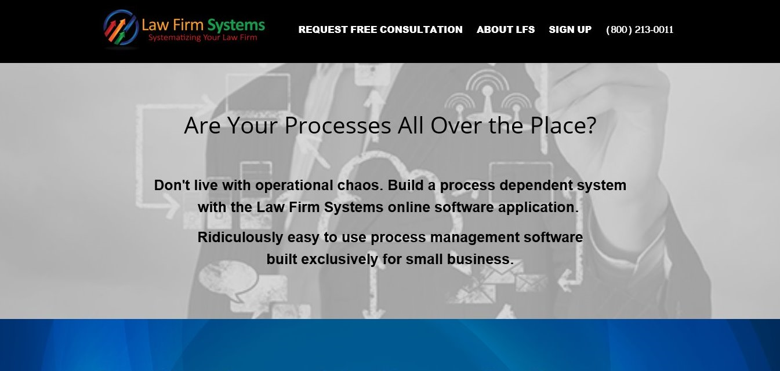
Literature Review
myCase
Law Firm Systems
FindLaw
quickBooks

Slide 5
System Methodology & Technology
Interview and
Observation
Technologies
Java Server Pages (JSP)
Bootstrap (HTML, CSS, JS)
MySQL & JDBC

Slide 6
Conclusion and Recommendation
Online Law Firm
System Sustainability
Completeness and marketing
Leading Law Firm Software in Tanzania
Think of Mobile technologies

